Slide 1



DEPARTMENT OF ARTIFICIAL INTELLIGENCE AND MACHINE LEARNING
Food7-AI Powered Restaurant Management System
SDG(8) - Decent Work and Economic Growth
SDG(9) - Industry, Innovation, and Infrastructure
SDG (12) - Responsible Consumption and Production
PROJECT REVIEW - 2
PROJECT GUIDE
Mentor Name :- Ms.M.Mohana Arasi
Designation :- Assistant Professor
PROJECT MEMBER
Gurruprasaath M K
Hemanth V
Hemvarshini S
23ADR052
23ADR061
22ADR062

Slide 2
INTRODUCTION
Food7 is a full-stack AI-powered system designed to automate and intelligently optimize every aspect of restaurant operations.
Smart billing with menu-driven cart and GST automation
AI call transcription and sentiment analysis using Groq Whisper
AI marketing content generation and multi-channel distribution
Real-time inventory tracking with predictive alerts
Analytics dashboard with revenue and sales insights

Slide 3
PROBLEM STATEMENT
Restaurant owners face multiple operational challenges that lead to revenue loss and high operational overhead.
Manual billing errors — handwritten orders and manual calculations lead to mistakes
No customer intelligence — phone calls are unrecorded, unanalyzed, and forgotten
Reactive inventory management — stock-outs and wastage discovered too late
Ineffective marketing — generic, untargeted promotions with no personalization
Fragmented systems — separate tools for POS, inventory, and marketing with no unified view
No data-driven decisions — owners rely on intuition rather than real sales analytics

Slide 4
PROJECT GOAL AND ITS SDG
Project Goal
SDG Alignment
SDG 8: Reduces manual labor burden
SDG 9: Applies cutting-edge AI
SDG 12: Predictive inventory reduces food wastage
.
Building a unified platform that replaces manual workflows with intelligent automation for sustainable growth.

Slide 5
EXISTING SYSTEM
Traditional restaurant management systems suffer from high dependency on manual effort and lack of AI integration.
Billing — Manual/basic POS, no menu integration
Call Management — No recording or analysis
Inventory — Manual spreadsheets, reactive restocking
Marketing — Generic WhatsApp broadcasts
Analytics — No real-time dashboard
AI Integration — None

Slide 6
PROPOSED IDEA
Food7 integrates six core modules to provide a seamless, zero-ongoing-AI-cost restaurant management experience.
Operations Modules
Smart Billing: Menu-driven cart
Smart Inventory: Real-time stock tracking
Analytics Dashboard: Revenue trends
AI Intelligence Modules
AI Call Analysis: Groq Whisper transcription
AI Marketing Generator: Groq LLaMA 3.3 70B
Multi-Channel Distribution: Gmail, WhatsApp, Instagram

Slide 7
SOFTWARE REQUIREMENTS
Software Stack:
Frontend — React 18, Vite, Tailwind CSS
Backend — Node.js, Express.js
Database — MongoDB Atlas (cloud)
AI — LLM — Groq API (LLaMA 3.3 70B)
AI — Speech — Groq Whisper Large V3
Authentication — JWT (JSON Web Tokens)

Slide 8
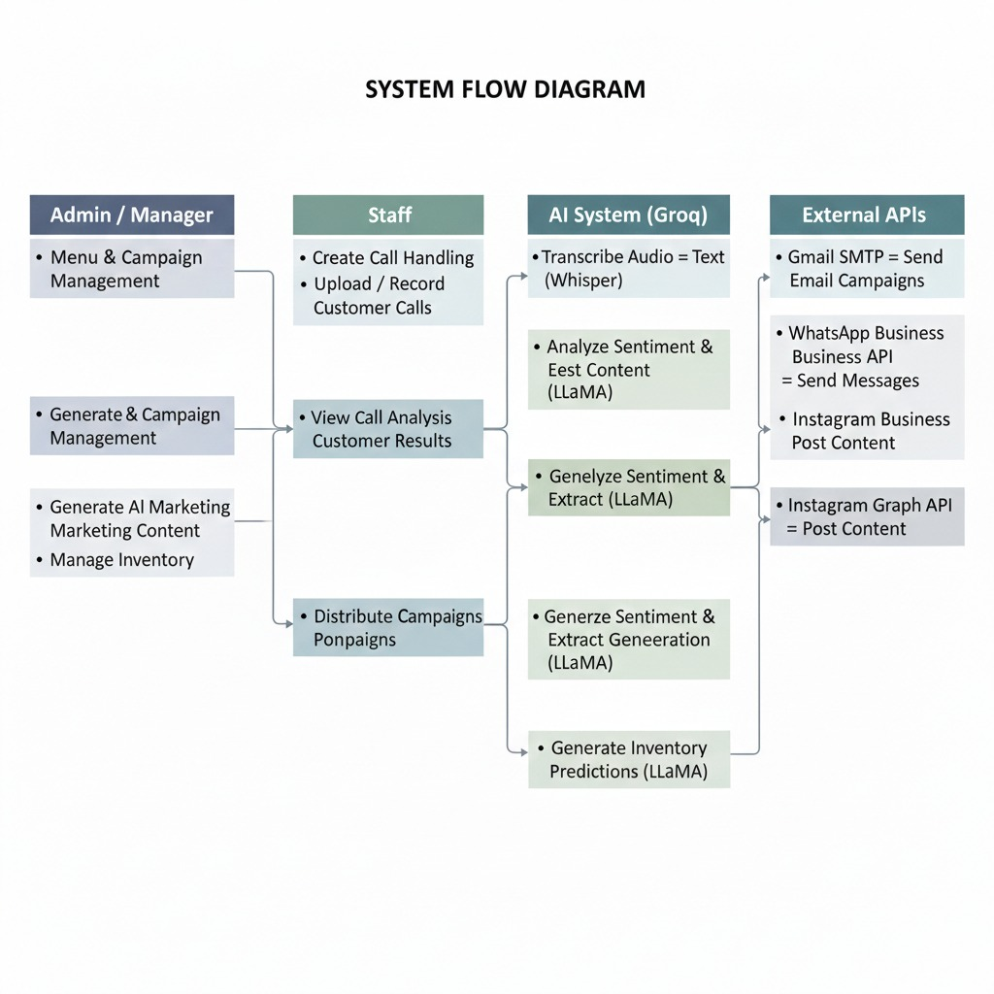
DESIGN OR SYSTEM FLOW

Slide 9
MODULES WITH DESCRIPTION
Authentication — JWT-based login — Role-based access
Billing — Smart POS — GST (5%), Cart, History
Call Analysis — AI intelligence — Groq Whisper, Sentiment
AI Marketing — Campaign generator — Groq LLaMA 3.3 70B
Inventory — Stock management — Auto-deduction, Alerts
Analytics — Business dashboard — Revenue trends, AI insights

Slide 10
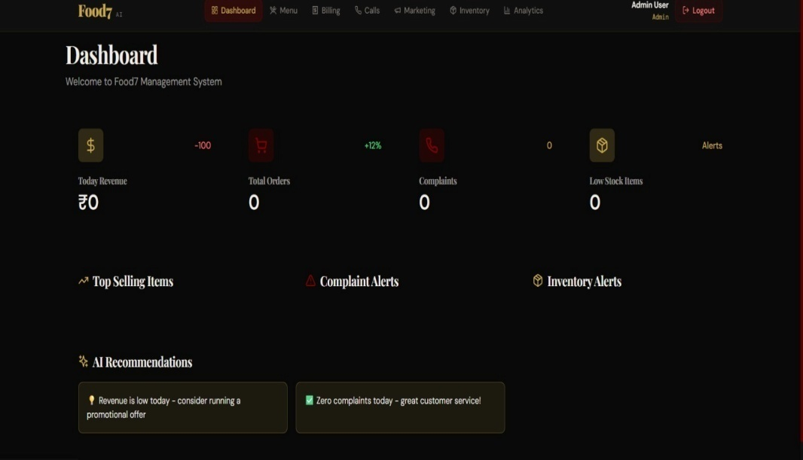
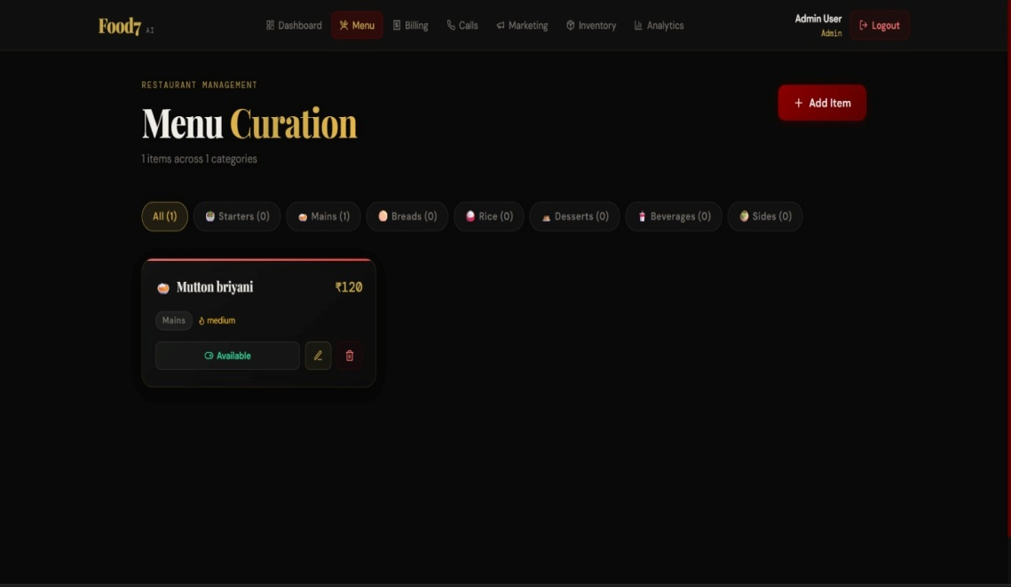
IMPLEMENTATION SCREENSHOTS

Slide 11
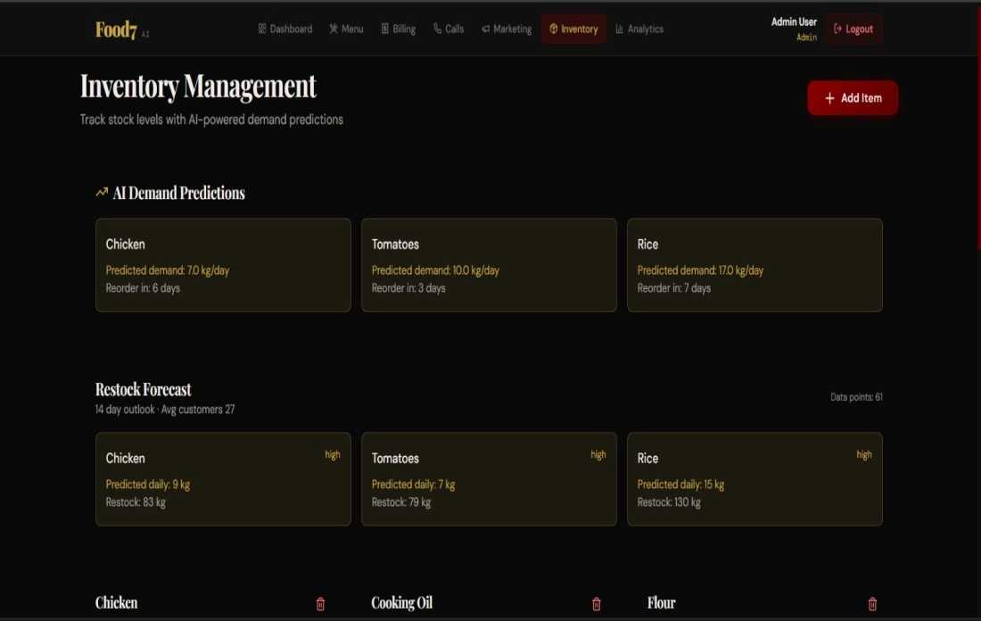
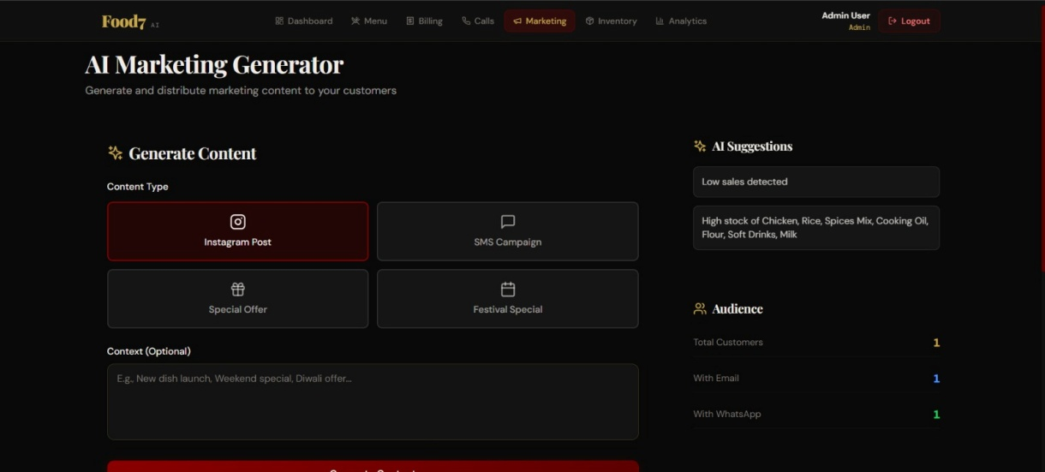
INTERMEDIATE RESULT SCREENSHOTS

Slide 12
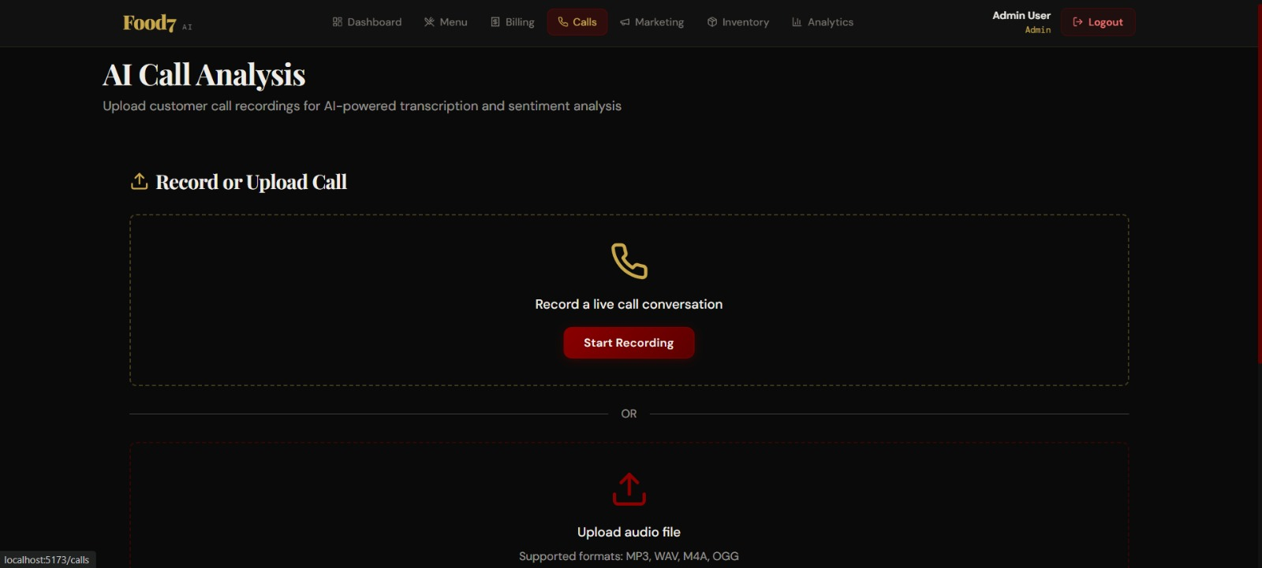
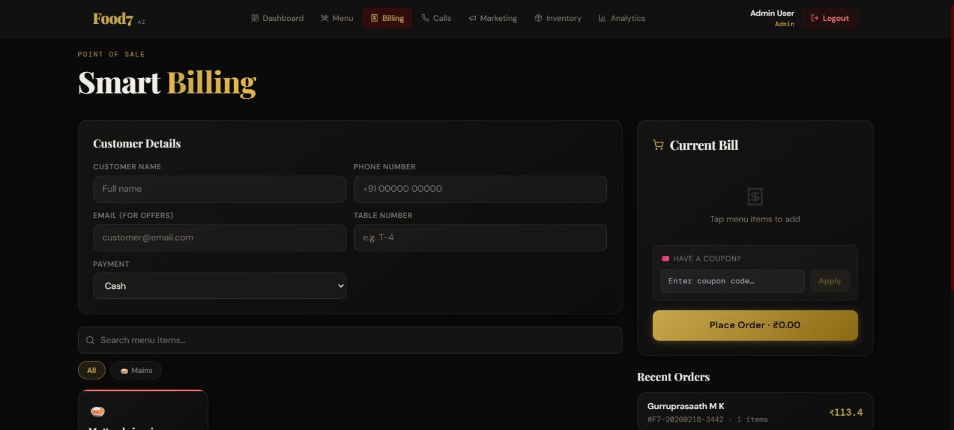
INTERMEDIATE RESULT SCREENSHOTS

Slide 13
REFERENCES
Groq API — https://console.groq.com/docs
Meta Business Cloud API — WhatsApp & Instagram integration
Nodemailer & MongoDB Atlas — Communication and data storage
React & Express.js — Frontend and Backend frameworks
OpenAI Whisper (2022) — Radford et al. (Speech-to-Text Research)
LLaMA 3 (2024) — Meta AI Research (Large Language Model)

Slide 14
THANK YOU

